Slide 1
Store Sales - Time Series Forecasting

Slide 2
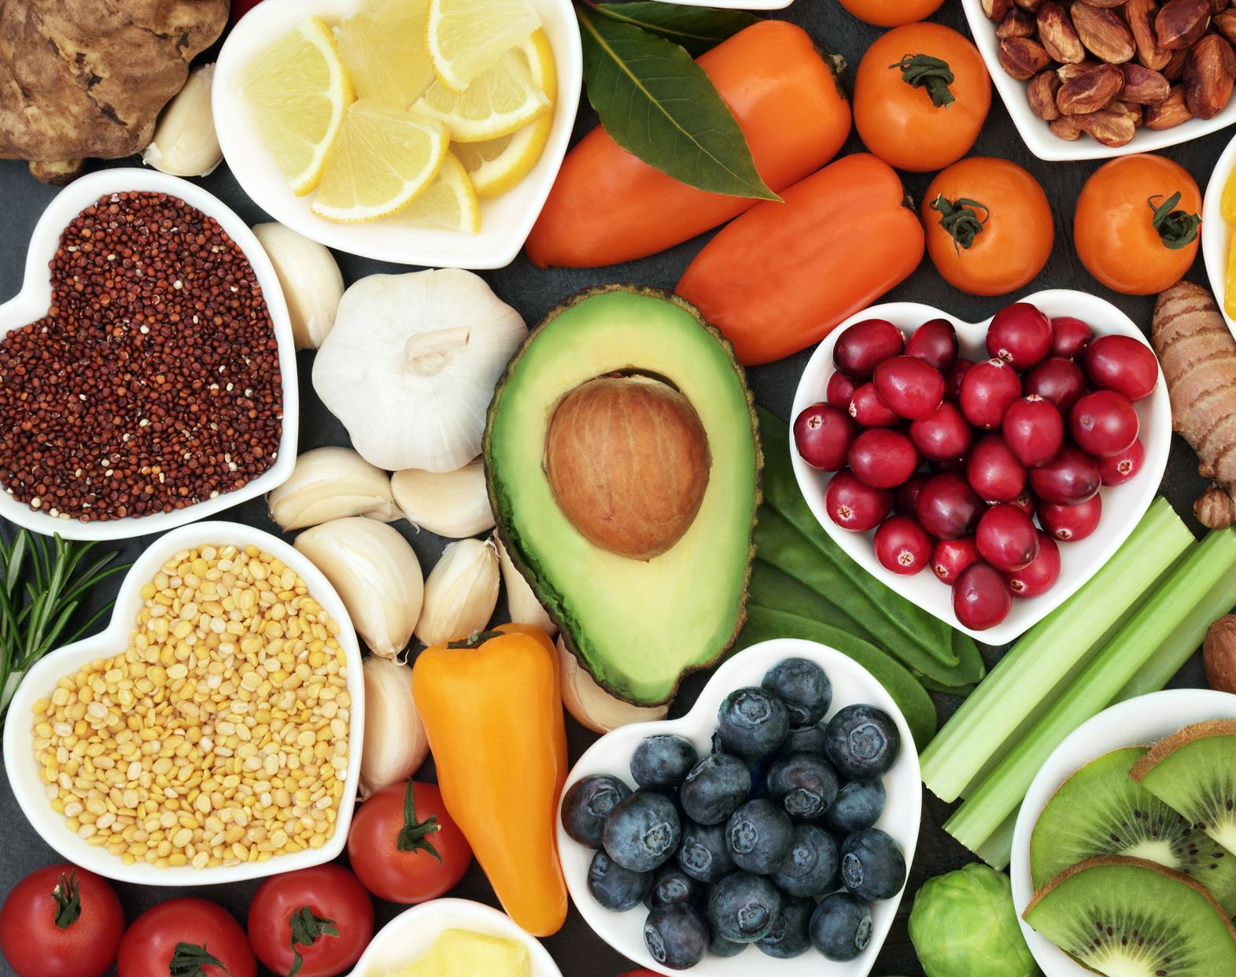
Problem Statement
Can you accurately predict sales for a large grocery chain?

Slide 3


Solution
Improved inventory management.
Better resource allocation.
Increased profitability and competitiveness
Holidays
Local events
Promotions
ML Model
To predict sales
Increased Sales
Cloud-Based Environment
Real Time Data

Slide 4
Audience
Retail managers and executives
Supply chain and logistics managers
Inventory and demand planners
Financial analysts and business intelligence professionals

Slide 5

Competitors
SAS Forecast Server
Oracle Demantra
IBM SPSS Modeler
SAP APO
JDA Software Group

Slide 6
Platform and models
Programming: Python
Anaconda
Jupyter notebook
Excel
Machine Learning(scikit-learn)
EDA(Pandas, Numpy)

Slide 7
Project Budget Proposal
Project Team Members
Project Manager, ML Engineer, Data Scientist, Quality assurance department
$ 60,000
Software Requirements
This includes costs for machine learning libraries and tools, as well as any proprietary software required for the project
$ 3,500
Infrastructure
This includes hardware costs for computers and servers, as well as cloud computing costs if using a cloud-based solution.
$ 10,000
Training & Support
Includes training the client resources and provide technical support post implementation
$ 5,700
Note: Prices are mentioned approximately and it may differ in future if in case additional resource or licensing involved

Slide 8
Application Development Process
Concept study
Data preparation and wrangling
Exploratory Data Analysis
Model Building
Model Evaluation
Model Deployment
Data Preparation
Kaggle and Other sources
Performing EDA and feature Engineering
Model Building and testing
Machine learning and Time Series algorithms
Model tuning for performance
Model Deployment
Saving model for predictions

Slide 9

Testing Process

Slide 10
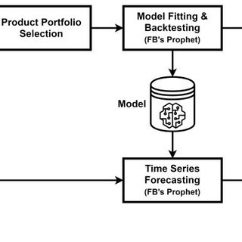
Train- Test Split - The data is split into two parts: a training set and a testing set. The model is trained on the training set and evaluated on the test set.
Back testing: The model is trained on historical data and then used to make predictions for future periods, which are compared with actual outcomes.

Slide 11
Security and Encryption
Data Encryption- Encrypt using secure algorithms such as AES or RSA.
Secure Storage- Data can be stored in cloud storage system or other secured databases.
Access Control- Access to the data and the AI/ML application should be strictly controlled and audited
Data backups- Regular data backups should be taken and stored in a secure location
Network security-Securing network with firewalls, intrusion detection systems, and other security measures to prevent unauthorized access.
Regular security updates- Regular updates should be applied to AI application and its dependencies.

Slide 12
Internationalization and Monetization
User testing
Translation
Localization
Text input and processing
Foster a community
Develop a pricing strategy
Expand features
Build a strong brand

Slide 13

References
Chat GPT
Kaggle.com
Wikipedia

